Slide 1


Manual Testing Preparation
By Suresh Thirumalai

Slide 2
Index
SNO | Topic | Slide Number
1 | SDLC | 99
2 | STLC | 100
3 | Manual Testing | 110
4 | Agile | 137
5 | JIRA | 160
6 | Interview Questions | 163

Slide 3
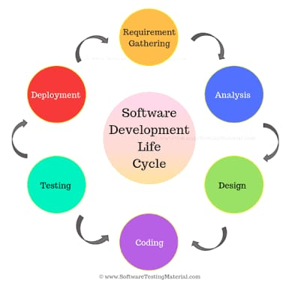
16. SDLC Software Development Life Cycle

Slide 4

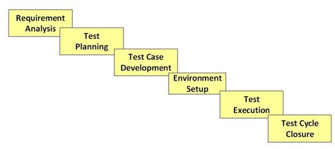
17. STLC Software Testing Life Cycle

Slide 5
Phase 1: Requirement Analysis
Test Team studies the requirements to identify the testable requirements
QA team interact with Client, BA, Tech Leads, System architects
To understand the requirements in detail
Deliverables
RTM
Automation Feasibility Report

Slide 6
Requirements Traceability Matrix (RTM)
It is a document that maps and traces the user requirement with test cases.
It is used to track the requirements and to check the current project requirements are met

Slide 7
Advantage of RTM
It confirms 100% test coverage
It highlights any requirements missing or document inconsistencies
It shows the overall defects or execution status with a focus on business requirements
It helps in analyzing or estimating the impact on the QA team's work with respect to revisiting or re-working on the test cases

Slide 8
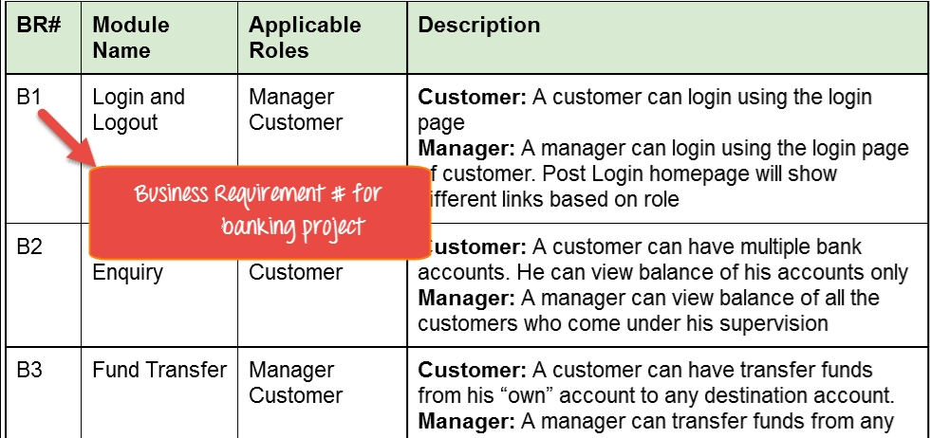
Business Requirement Document (BRD)

Slide 9
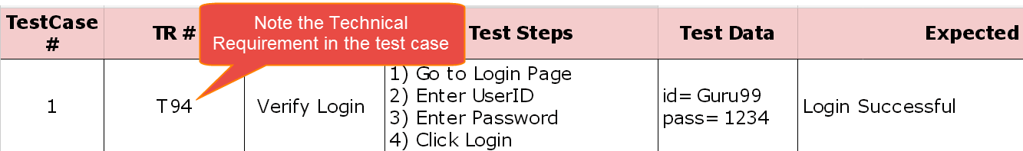
Technical Requirement Document (TRD)

Slide 10
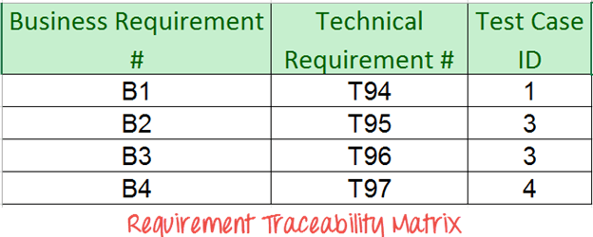
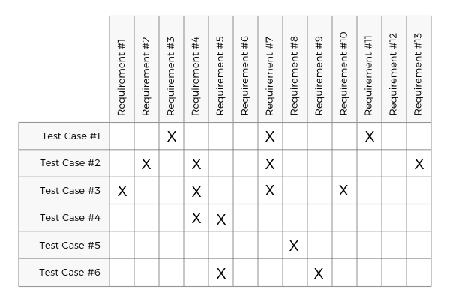
RTM
RTM Table

Slide 11
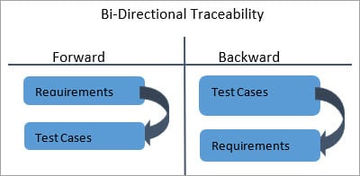
Types:
Forward Traceability
Backward Traceability

Slide 12
Phase 2: Test Planning
Senior QA Manager determines Effort & Cost estimates
Preparation of Test Plan Document for various types of testing
Tool selection
Resource planning and determining R&R
Training Requirements
Deliverables:
Test Plan Document
Effort Estimation Document

Slide 13
Test Plan Document
Test Plan is a document describing the
scope,
approach,
resources, and
schedule of planned test activities.
it deals with test coverage, features to be tested, features not to be tested, estimation, scheduling and resource management.

Slide 14
Create Test Plan Document
Follow the below steps below to create a test plan.
1. Analyze the product
2. Design the Test Strategy
3. Define the Test Objectives
4. Define Test Criteria
5. Resource Planning
6. Plan Test Environment
7. Schedule & Estimation
8. Determine Test Deliverables

Slide 15
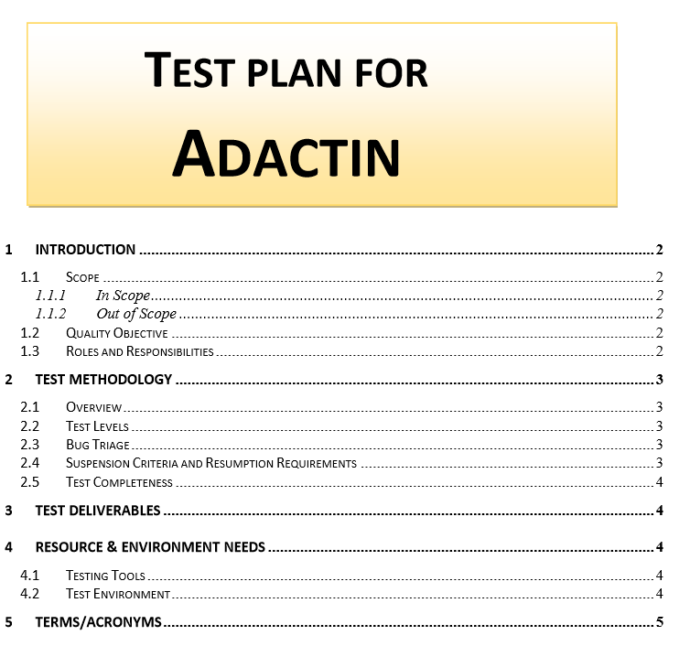

Slide 16
Phase 3: Test Case Development
Create test Cases, Automation Scripts
Review and Verify test cases & test scripts
Create Test Data
Deliverables
Test Cases/Scripts
Test Data

Slide 17
Phase 4: Environment Setup
Understand required architecture, environment set-up
Prepare H/W , S/W requirement list
Setup Test Environment and test data
Perform Smoke Test on the build to do a readiness check of the given environment
Deliverables
Environment Ready with Test Data Setup
Smoke Test Results

Slide 18
Test Environment Setup
System and applications
Test data
Database server
Front-end running environment
Client operating system
Browser
Hardware includes Server Operating system
Network
Documentation required like reference documents/configuration guides/installation guides/ user manual

Slide 19
Phase 5: Test Execution
Execute tests as per Plan
Document test results and log defects for failed cases
Bugs will be reported to dev team for correction
Retest the Defect fixes
Track the defects to closure
Deliverables
Test Cases – Updated Result
Defect Reports

Slide 20
Phase 6: Test Cycle Closure
Prepare Test closure report
Evaluate cycle completion criteria
Prepare test metrices.
Test Result analysis
Deliverables
Test Closure Report

Slide 21
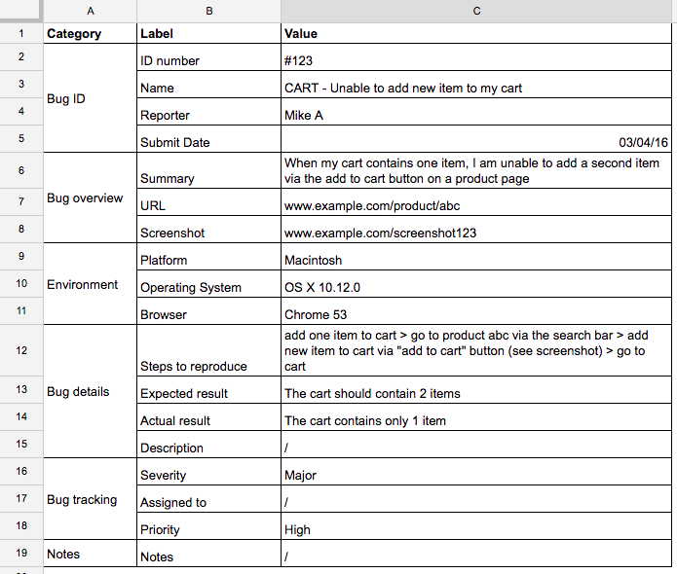
Bug Report

Slide 22
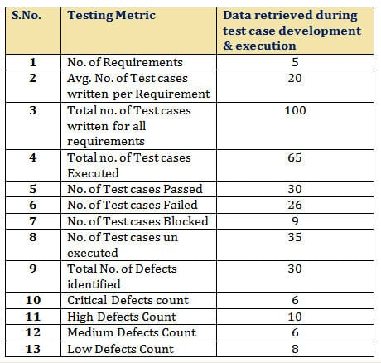
Test Summary Report: Testing Metrics

Slide 23
Test Strategy
A strategy plan for defining the testing approach, what you want to accomplish and how you are going to achieve it.
Writing a Test Strategy effectively is a skill every tester should achieve in their career. It initiates your thought process which helps to discover many missing requirements. Thinking and test planning activities help a team to define the Testing scope and Test coverage.
It helps Test managers to get the clear state of the project at any point. The chances of missing any test activity are very low when there is a proper test strategy in place.

Slide 24
Feasibility Study
Feasibility Study: Feasibility study explores system requirements to determine project feasibility. There are several fields of feasibility study including economic feasibility, operational feasibility, technical feasibility. The goal is to determine whether the system can be implemented or not. The process of feasibility study takes as input the requirement details as specified by the user and other domain-specific details. The output of this process simply tells whether the project should be undertaken or not and if yes, what would the constraints be. Additionally, all the risks and their potential effects on the projects are also evaluated before a decision to start the project is taken.

Slide 25
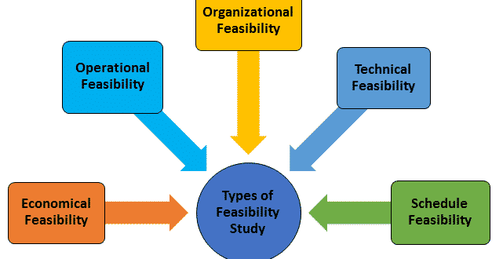
Types of feasibility Study

Slide 26
Story Point Estimations
Story point Estimations are done in Agile projects using different techniques like
Planning Poker,
Bucket System,
Affinity Mapping,
T-Shirt Sizes (sizes: XS (Extra Small), S (Small), M (Medium), L (Large), XL (Extra Large))
Dot Voting

Slide 27
Important Questions in STLC
1. How to create RTM?
2. How to create Test Plan?
3. How to prepare Feasibility Report?
4. How to estimate Effort?
5. What is Test Strategy?

Slide 28
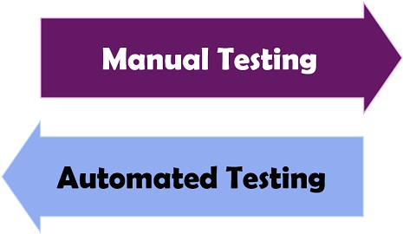
Software Testing
The process, to evaluate the functionality of a software application.
Activity to check whether the actual results match the expected results and to ensure that the software system is defect/bug free
It can be done manually or using automated tools

Slide 29
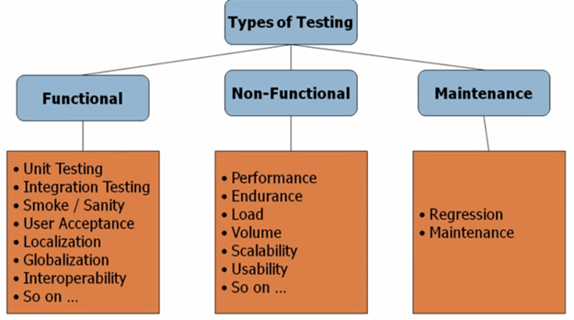
Types of Testing (Manual/Automation)

Slide 30
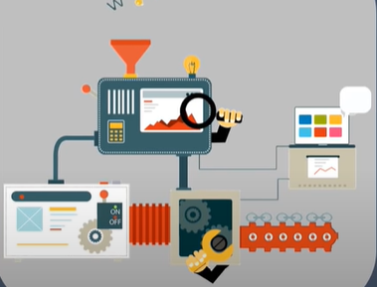

1. Functional Testing
Checks whether the application is providing all the functionalities that were mentioned in the functional requirement of the application.

Slide 31
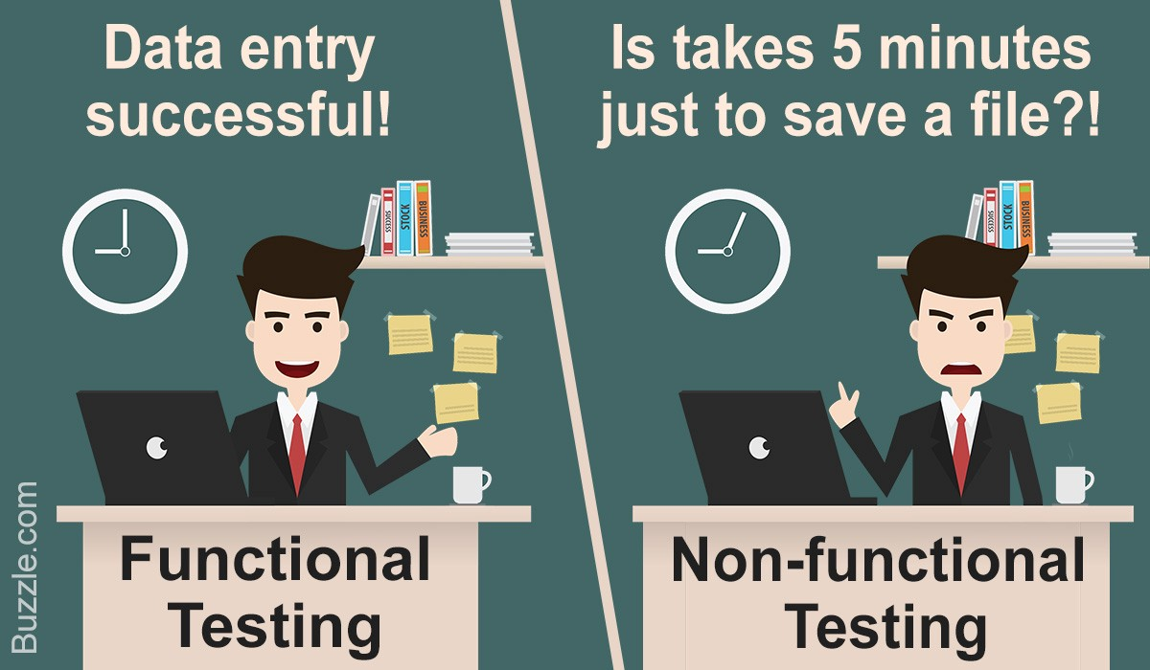
2. Non-Functional Testing
To check non-functional aspects (performance, usability, reliability, etc) of a software application.
It is designed to test the readiness of a system as per nonfunctional parameters which are never addressed by functional testing

Slide 32

3. Maintenance
Regression Test
Slide No: 182

Slide 33

18. Manual Testing (Functional)
It is a type of software testing where testers manually test cases without using any automation tools.
It is most primitive of all testing types and helps to find bugs in the software system.
Any new application must be manually tested before its testing can be automated.
Manual testing requires more effort but is necessary to check automation feasibility.

Slide 34
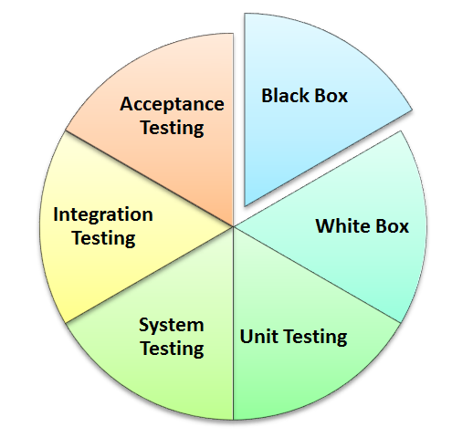
Techniques in Manual testing

Slide 35
How to perform a Test:
1. Read and understand the software project documentation / guides
2. Draft Test cases that cover all the requirements mentioned in the documentation
3. Review the test cases with Team Lead, Client
4. Execute the test cases
5. Report Bugs
6. After bugs fixed, execute failed test cases.

Slide 36
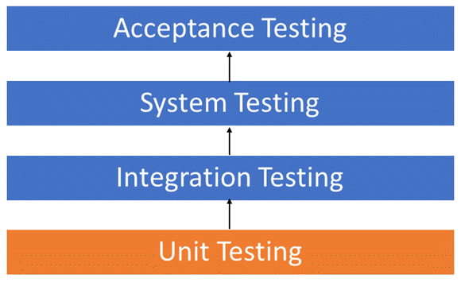
Software Testing Levels (Hierarchy)

Slide 37


1. Unit Testing
Individual units or components of a software are tested
It is done during the development of application by developers
A unit may be an individual function, method, procedure, module, or object
Tools
JUnit
NUnit

Slide 38

2. Integration Test
Software modules are integrated logically and tested as a group
It focuses mainly on the interfaces and flow of data/information between the modules
Example:
An application has 3 modules:
Login Page, Mail box, Delete emails

Slide 39

3. System Testing
It validates the complete and fully integrated software product
Purpose is evaluate the end-to-end system specifications
Different Types of System Testing
Smoke Test,
Sanity Test,
Regression Test,
Black Box,
White Box,
User Acceptance Test,

Slide 40

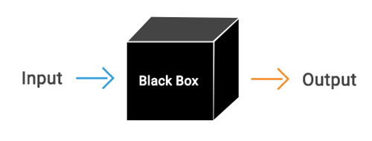
Black Box Testing
It is tested without looking
at the internal code structure,
implementation details and
knowledge of internal paths of the software.
This type of testing is based entirely on
software requirements and specifications.

Slide 41
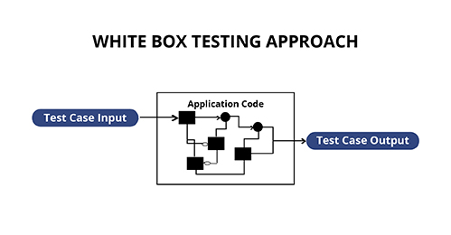

White box testing
Testing software’s internal structure, design, and coding.
In this type of testing, the code is visible to the tester.
It focuses primarily on verifying
the flow of inputs & outputs through the application,
improving design and usability,
strengthening security.

Slide 42

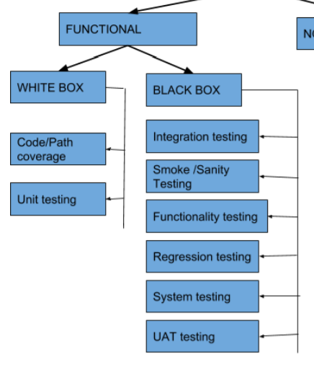
Black Box Vs White Box

Slide 43
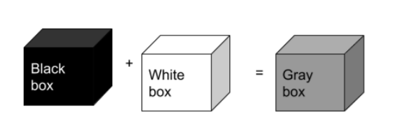
Grey box testing
Gray-box testing is a combination of white-box testing and black-box testing.
Grey box testing is when the tester has a partial understanding of the internal structure in the system under test.
Grey box testing is a process for debugging software applications by making an input through the front-end, and verifying the data on the back-end

Slide 44
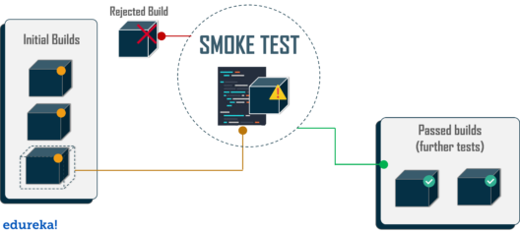

Smoke Testing
To confirm that the critical functionalities of the program
are working fine after software build

Slide 45
When Smoke Testing?
"before" any detailed functional or regression tests are executed on the software build.
To decide if a build is stable enough to proceed with further testing
Why?
- If the build is imperfect/defective, further testing would be waste of time and resources.
- To detect early major issues.

Slide 46
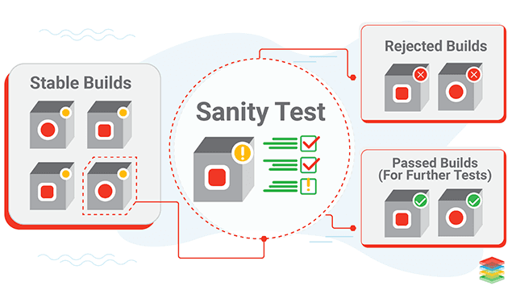
Sanity Testing?
To check the new functionality/bugs have been fixed.

Slide 47

Smoke vs Sanity
Smoke Test
It is like General Health Check Up
Sanity Test
It is like specialized health check up

Slide 48
Ad-hoc Testing
When a software testing performed without proper planning and documentation, it is said to be Adhoc Testing. Such kind of tests are executed only once unless we uncover the defects. Adhoc Tests are done after formal testing is performed on the application.

Slide 49
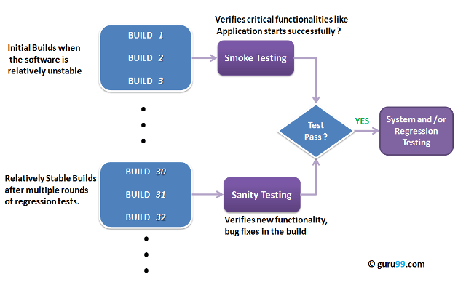


Slide 50
Regression Testing
It is done to verify that a code change in the software does not impact the existing functionality of the product.
This is to make sure the product works fine with new functionality, bug fixes or any change in the existing feature.
Previously executed test cases are re-executed in order to verify the impact of change.

Slide 51
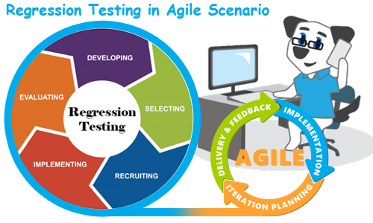
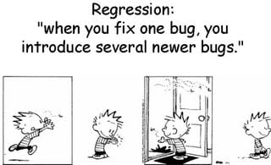
Regression

Slide 52
When Regression Testing?
After the changes in requirements and code modified according to the requirement
After new feature added to the software
After defect fixed
After performance issue fixed
After alterations to an application's hosting environment.

Slide 53
Selecting Test Cases for Regression Testing
1. Select test cases for Regression; there are recent code changes /functional changes
2. Select test cases that map to the business requirements
3. Select test cases for Regression testing in areas with frequent bugs/defects
4. Select test cases for Regression testing of the areas which are visible to the user
5. Select all integration test cases for Regression testing
6. Select all complex test cases for Regression testing
7. Select test cases based on priorities for Regression testing
8. Select test cases for Regression testing based on criticality and impact of bug fixes
9. Select a sample of successful and failed test cases for Regression testing
10. Functionalities which are more visible to the users

Slide 54
Regression check is covered under two categories:
Sprint Level Regression
End to End Regression
1) Sprint Level Regression
It is done mainly for the new functionality or the enhancement that is done in the latest sprint. Test cases from the test suite are selected as per the newly added functionality or the enhancement that is done.
2) End-to-End Regression
End-to-End Regression includes all the test cases that are to be re-executed to test the complete product end to end by covering all the core functionalities of the Product.

Slide 55
Regression Testing Steps:
Select the Tests for Regression.
Choose the apt tool and automate the Regression Tests
Verify applications with Checkpoints
Manage Regression Tests/update when required
Schedule the tests
Integrate with the builds
Analyze the results

Slide 56
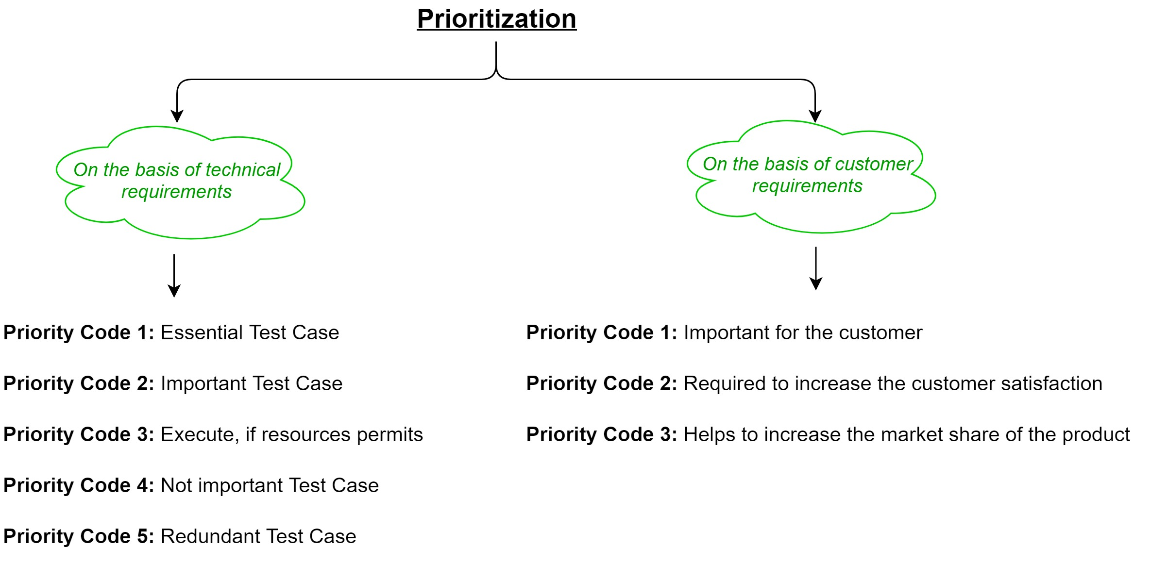

Slide 57
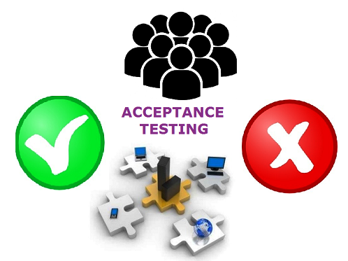
UAT – User Acceptance Testing
Testing a software by the user or client
to determine whether it can be accepted or not.
This is the final testing performed
once the functional, system & regression testing
are completed

Slide 58
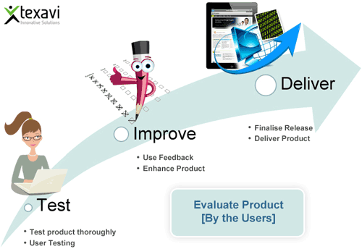


After UAT…

Slide 59
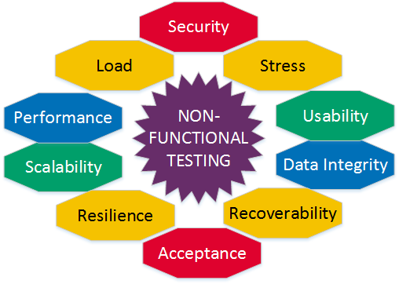
Non-Functional Testing

Slide 60
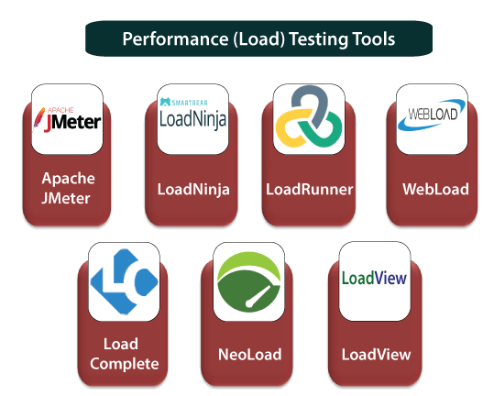

TESTING | Description | Tools
Performance Test | To Verify Speed, response time, reliability
Load Test | How application behaves when multiple users access simultaneously
Stress Test | To verify the stability and reliability
Volume Test | To analyse the system performance by increasing the volume of data in DB
Stability Test | To check if the app will crash at any point of time
Compatibility Test | Software should be installable on all versions of OS

Slide 61
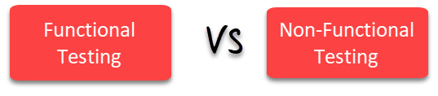
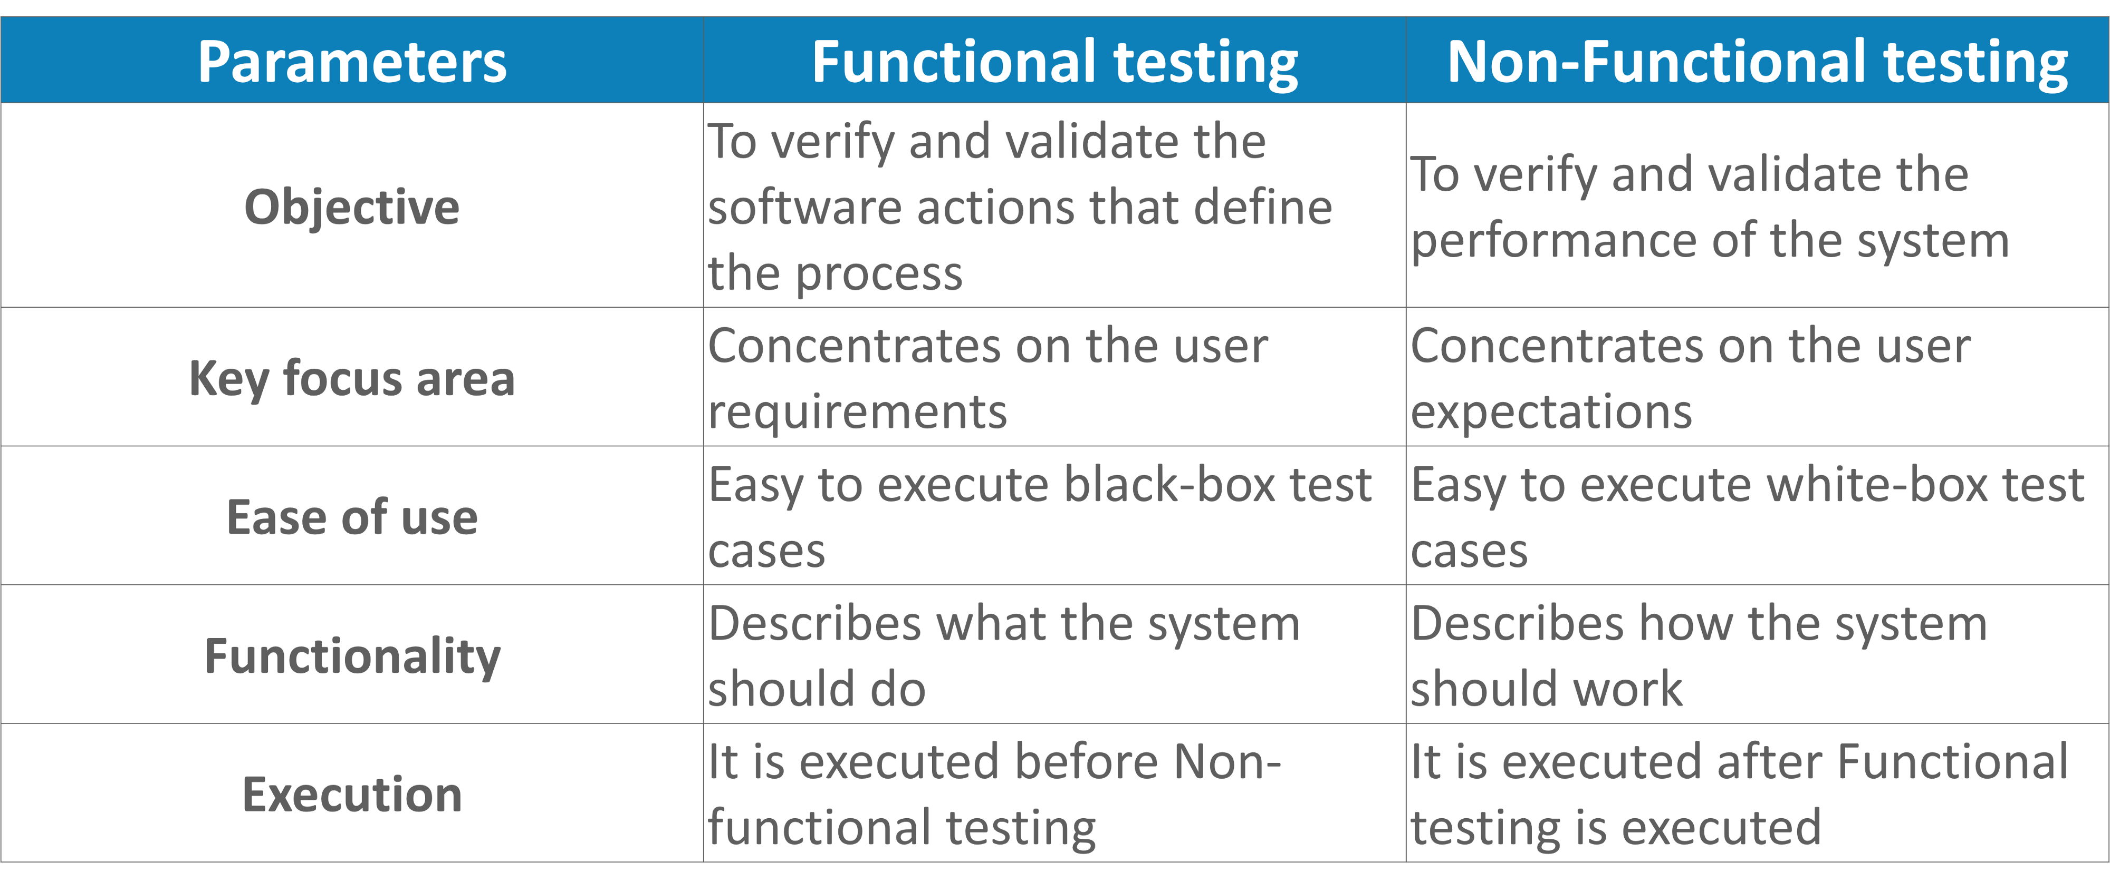
sdsd

Slide 62
How to write a Test Scenario?
Test Scenario
Test Case
Test Step
Actual Result
Expected Result
Status
Comment

Slide 63
Test Scenario and Test cases
Test Scenario:
It is one liner statement which tell us about what to test
Ex: Check Login functionality
Test Case:
Test scenario consists of a detailed test procedure
Here Login Test Scenario has 4 test cases.
Ex: Check Using valid User Id and valid Password
Check Using Invalid User Id and valid Password
Check Using valid User Id and Invalid Password
Check Using Invalid User Id and Invalid Password

Slide 64
Test Scenario vs Test cases
Test Scenario
" What to be tested“
Test case
" How to be tested“
Test Script:
Test scripts are used in automated testing.
Sometimes, a set of instructions (written in a human language), used in manual testing.

Slide 65
Scenario Id | Test Case Id | Test Case | Test Case Description | Test Step | Test Step Description | Expected Result | Actual Result | Status | Comment
TS001 | TC001 | Checking login function using valid Login and valid Username | Test the login functionality of Amazon application to make sure user is allowed to the site using valid user name and password | 1 | Launch the application | Application launched properly | Application launched successfully | Pass
 |  |  |  | 2 | Navigate to the login Page | Username and password fields are displayed | Username and password fields are displayed | Pass
 |  |  |  | 3 | Enter valid username in username field | Username field accepts input value as valid username | Username input accepted | Pass
 |  |  |  | 4 | Enter valid password in the password field | Password field accepts input value as valid Password | Password input accepted | Pass
 |  |  |  | 5 | Click on Login Button | Navigated to HomePage and shows name of the user in homepage | Name of the user is displayed in the homepage | Pass
Important

Slide 66
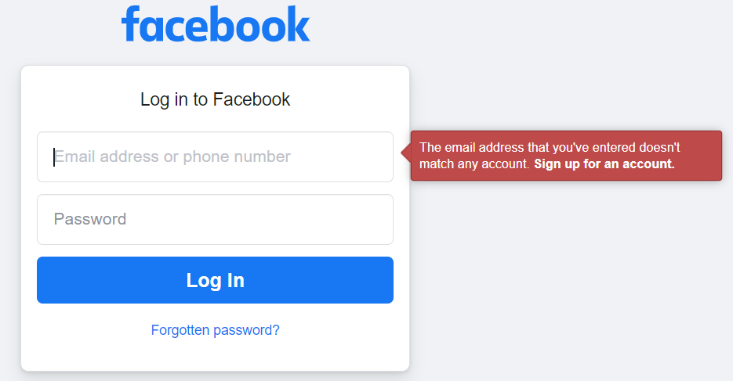
Negative Test case:

Slide 67
Verification vs Validation
Verification:
The verifying process includes checking documents, design, code, and program.
(Ex: Spelling mistake)
Validation:
It is a dynamic mechanism of Software testing and validate the actual Product.
(Ex: Actual meets Expected)

Slide 68
Entry Criteria :
Test environment availability
Test scope definition and finalization
Types of testing defined & finalized
Test cycles & schedule is planned & Signed off
test resources available
Software under test knowledge is available
Stakeholders are identified and involved
Code is deployed in test environment
Test data is available in the test environment.
Exit criterias are signed off

Slide 69
Exit Criteria:
The following exit criteria should be considered for completion of a testing phase:
Ensuring all critical Test Cases are passed
Achieving complete Functional Coverage.
Identifying and fixing all the high-priority defects
Deadlines meet or budget depleted.
Desired and sufficient coverage of the requirements and functionalities under the test.
All the identified defects are corrected and closed.
No high priority or severity or critical bug has been left out.
Testing de-scoped due to any reason.
Sign-off received from all stakeholders

Slide 70
Testing can be stopped when: 1
Requirements:
100% Requirements coverage is achieved.
Defects:
Defined / Desired Defect count is reached.
All Show Stopper defects or Blockers are fixed and No known Critical / Severity 1 defect is in Open Status.
All High Priority defects are identified and fixed.
Defect Rate falls below defined acceptable rate.
Very few Medium Priority defects are open and have a workaround in place.
Very few low priority open defects that do not impact software usage.
All High Priority defects are re-tested and closed and corresponding Regression scenarios are successfully executed.

Slide 71
Testing can be stopped when: 2
Test Coverage:
Test Coverage should be 95% achieved.
Test case Pass Rate should be 95%. This can be calculated by formula
( Total No of TCs Passed / Total number of TCs ) * 100.
All critical Test cases are passed.
5% Test cases can be failed but the Failed Test cases are of low priority.
Complete Functional Coverage is achieved.
All major functional / business flows are executed successfully with various inputs and are working fine.
Deadlines:
Project Deadline or Test Finish deadline is reached.

Slide 72
Testing can be stopped when: 3
Test Documents:
All Test Documents / deliverables (Example – Test Summary Report) are prepared, reviewed and published across.
Budget:
Complete Testing Budget is exhausted.
“Go / No Go” Meetings:
“Go / No Go” meeting has been conducted with stakeholders and a decision is made whether the project should go to production or not.

Slide 73
Manual to Automation prerequisite
Build should always be stable.
Get the functionalities to repeat.
Filtering the automated test cases.
Skilled and experienced resources.
A module or application that does not change frequently.
Segregation of test cases that needs to be automated.
Use of reusable functions and procedures

Slide 74
Sample Test Cases
1. OTP
2. ATM
3. Add to Cart

Slide 75
Scenarios to Test OTP (One-Time Password)
1) OTP should be generated within time period.
2) Limitations of number of OTP generation for single authentication.
3) It is received only on registered Mobile Number / E-mail Address.
4) Network delay for expiry of One-Time Password.
5) Verify that once expired, it should not be used for any authentication.
6) Verify that once used, it should not be allowed to use again.
7) Verify that resend OTP functionality is working properly.
8) Verify that once user resent the OTP, the old one should be of no use.
9) Availability of Help and Documentation Link for OTP usage.
10) Verify for Case Sensitiveness.
11) Check for types of characters OTP supports: Only Digits, Only Alphabets, Alphanumeric.
12) How many times user can provide invalid OTP?
13) After multiple invalid try, verify that system temporarily blocks the account.
14) Verify that after temporary blocking of account, system does not send the one-time password.
15) Provide an invalid Phone Number or E-Mail address and submit the OTP. Check the validation.
16) Are the one-time password patterns are predictable?

Slide 76
Test Cases for ATM
Given below are the various test cases for ATM.
1) Verify if the card reader is working correctly. A screen should ask you to insert the pin after inserting the valid card.
2) Verify if the cash dispenser is working as expected.
3) Verify if the receipt printer is working correctly. Which means it can print the data on the paper and the paper comes out properly.
4) Verify if the Screen buttons are working correctly. For touch screen: Verify if it is operational and working as per the expectations.
5) Verify if the text on the screen button is visible clearly.
6) Verify the font of the text on the screen buttons.
7) Verify each number button on the Keypad.
8) Verify the functionality of the Cancel button on the Keypad.
9) Verify the text color of the keypad buttons. The numbers should be visible clearly.
10) Verify the text color and font of the data on the screen. The user should be able to read it clearly.
11) Verify the language selection option. If the messages or data are displayed in the selected language.
12) Insert the card, the correct pin, and print the receipt for available balance.
13) Verify the receipt printing functionality after a valid transaction. Whether the printed data is correct or not.
14) Verify how much time the system takes to log out.
15) Verify the timeout session functionality.
16) Verify the deposit slot functionality depending on its capability (Cash or cheque or both) by inserting a valid cheque.
17) Verify using different cards (Cards of different banks).

Slide 77
Verifying the Message
18) Insert the card and an incorrect PIN to verify the message.
19) Verify the message when there is no cash in the ATM.
20) Verify the messages after a transaction.
21) Verify if a user will get a correct message if a card is inserted incorrectly.
Messages for each and every scenario should be verified.
Cash Withdrawal
22) Verify the cash withdrawal functionality by inserting some valid amount.
23) Verify if a user can perform only one cash withdrawal transaction per PIN insert.
24) Verify the different combinations of operation and check if there will be a power loss in the middle of the operation.

Slide 78
Negative Test cases
25) Verify the functionality by entering a wrong pin number for 3 or more times.
26) Verify the card reader functionality by inserting an expired card.
27) Verify the deposit slot functionality by inserting an invalid cheque.
28) Verify the cash withdrawal functionality by inserting invalid numbers like 10, 20, 50 etc.
29) Verify the cash withdrawal functionality by entering an amount greater than the per day limit,
30) Verify the cash withdrawal functionality by entering an amount greater than per transaction limit.
31) Verify the cash withdrawal functionality by entering an amount greater than the available balance in the account.

Slide 79
E-commerce Websites: Shopping cart
Add one item to the cart and verify.
Increase the quantity of the item from the cart and verify.
Add the same item multiple times and verify.
Add multiple items of different types and verify.
Remove some items from the cart and verify.
Remove all items from the cart and then verify.
Click on an item in the cart and verify that the user is redirected to the product detail page.
Check that the price of the cart is discounted when we apply a valid coupon.
Check that the price of the cart is not discounted when we apply an invalid coupon.
Add item(s) to the cart, close the browser and reopen the same site.
Add item(s) to the cart, close the browser and reopen the same site.
Verify the product QTY field when the product is out of stock.
Verify that the user is able to add a text note for all products.
Verify that the user is able to add any or all products to his wishlist by clicking on the wishlist link.
Verify that the user is able to mark his order as a gift.
Verify that the user is able to add any a gift message.
Verify that the user is redirected to the checkout page after clicking on the checkout button.
Verify the cart total when the exclusive tax is enabled from the admin end.
Verify the cart total when the inclusive tax is enabled from the admin end.

Slide 80
Checkout flow
Ensure that user can access the Checkout Page only after adding the product to the cart.
Ensure that Checkout Address Page consists of all the details of the product such as Name, Quantity, Amount, etc.
Ensure that only registered users are allowed to access the Checkout Address Page.
Ensure that Name, Street Address, City, State, Country, Postal code is the mandatory field in the Checkout Address page (Shipping Address).
Ensure that Name, Street Address, City, State, Country, Postal code is the mandatory field in the Checkout Address page (Billing Address).
Ensure that error message is displayed when the user enters invalid input in all the mandatory field in the checkout address page.
Ensure that Back to cart link is available so that user can modify the cart content if needed.
Ensure that user is redirected to Checkout payment page only after entering valid mandatory details in the checkout Address page.
Ensure that error message is displayed when the user leaves any one of the mandatory fields in the checkout Address page.
Ensure that Next Button and Cancel Button are available in the Checkout Address Page.
Check that a user is able to apply a valid coupon.
Verify the error message for the invalid coupon.
Check that user is able to make his order as a gift.
Ensure that the user is able to add any gift message.
Check order price when gift and wrapping charges are applicable.
Check the shipping price.
Check the shipping price tax.
Check the payment options.
Ensure that Name on Card, Card Number, Expiration date, CWW2 are mandatory fields in the Payment Page.
Ensure that error message is displayed when the user enters invalid input in all the mandatory field on the Payment Page.
Ensure that error message is displayed when the user leaves any one of the mandatory fields in the Payment Page.
Ensure that the user is redirected to the third party (Vender) page.
Ensure that the user is redirected to the third party (PayPal) page if he is going to pay through a third party payment gateway (PayPal).
Place an order where order total price is Zero (0).
Place an order where the total discount is more than the entire order.
Place an order by double clicking on the submit Button.

Slide 81
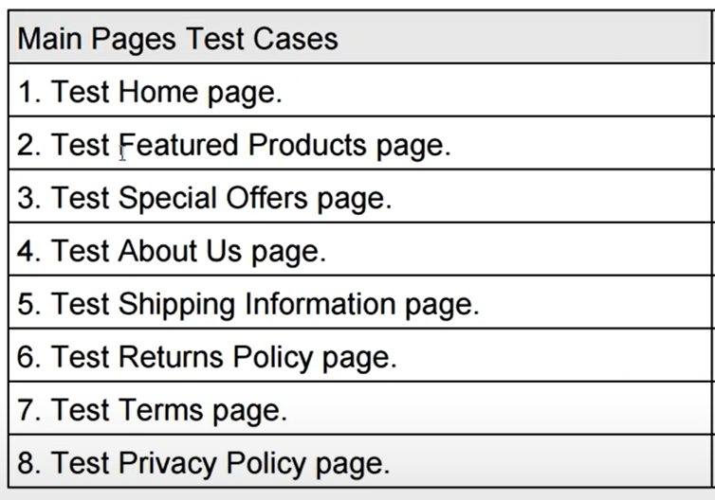
Modules for E-Commerce site

Slide 82
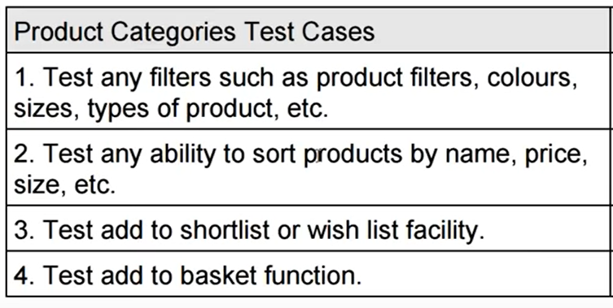
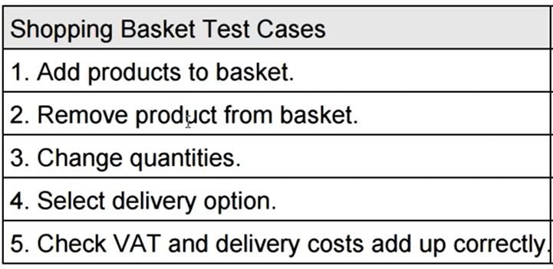
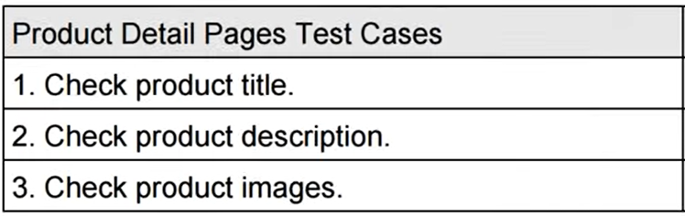
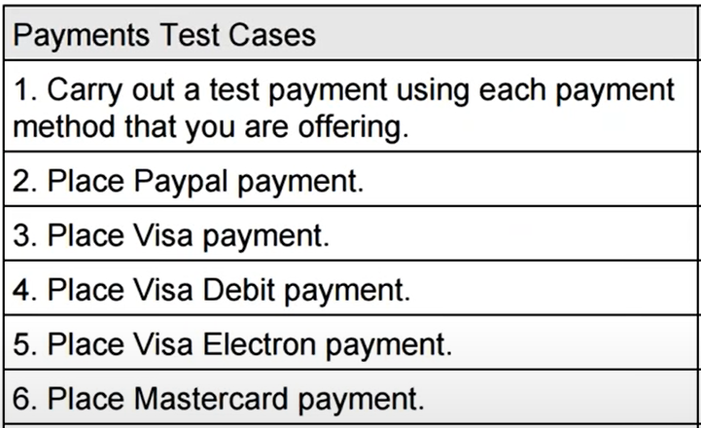
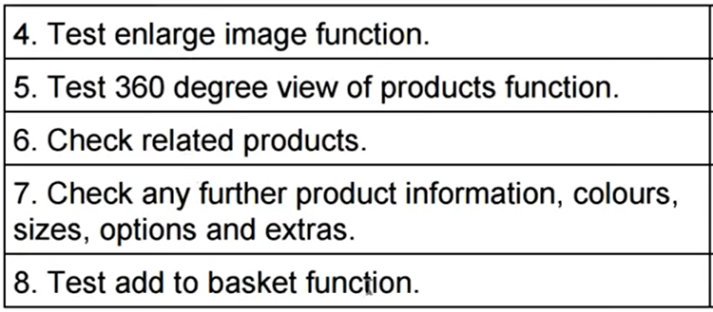
Test Cases

Slide 83
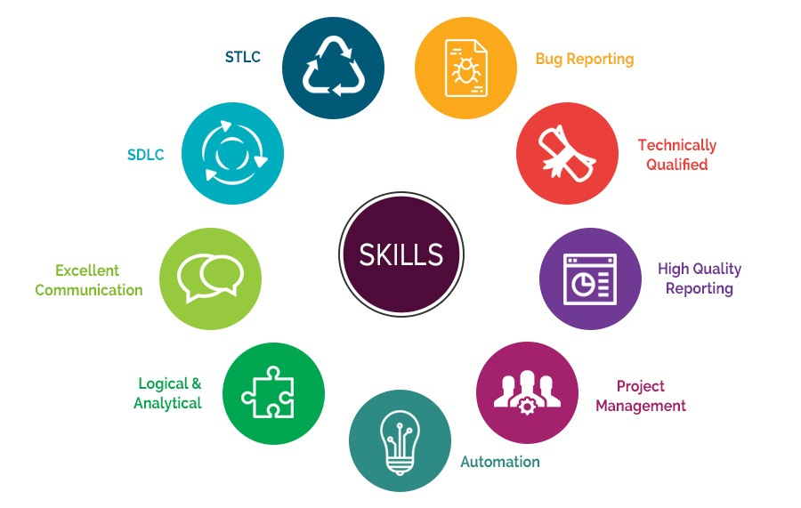
Skills required to become a Software Tester

Slide 84
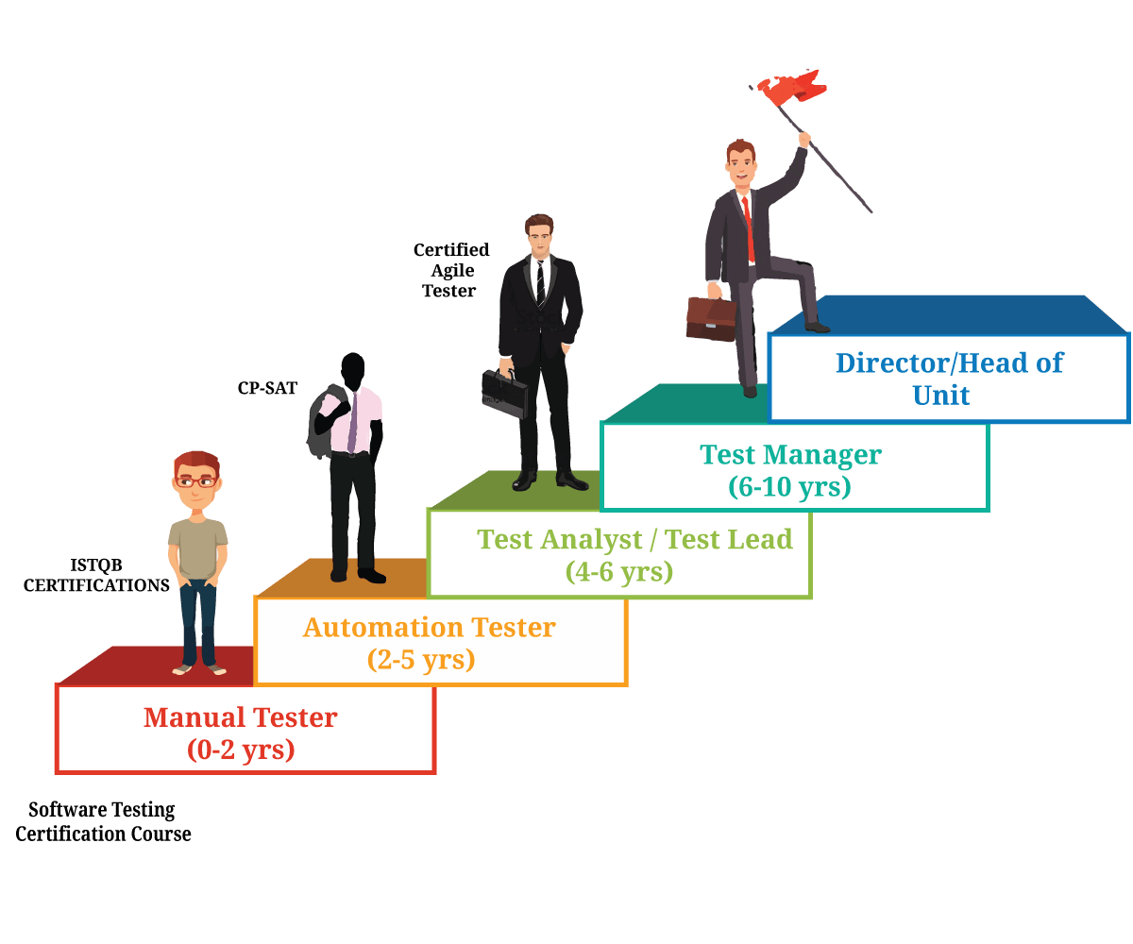


Software Tester Career Path

Slide 85
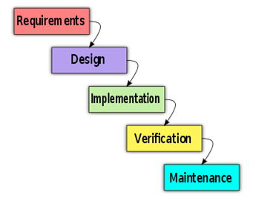
Software Methodologies
Waterfall Model

Slide 86
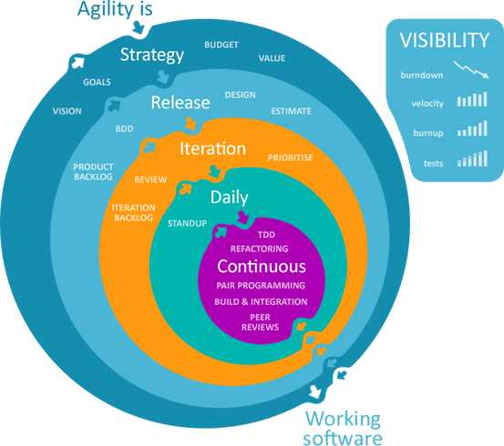
Agile Methodology

Slide 87

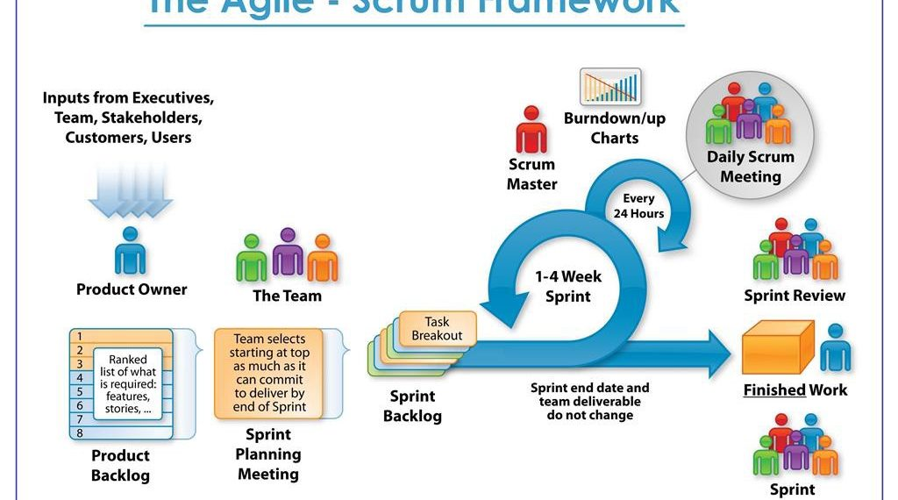
Agile – Scrum Methodology

Slide 88
19. Agile
It is a practice that promotes continuous iteration of development and testing throughout the software development lifecycle of project.
Both Dev and testing activities are concurrent unlike Waterfall model.
Agile emphasizes on 4 core values:
Individual and team interactions over processes and tools
Working software over comprehensive documentation
Customer collaboration over contract negotiation
Responding to change over following a plan

Slide 89

Agile
Waterfall
Incremental and iterative approach
It is broken into individual models
Customer see the product frequently ---- -------can make the changes to the project
Error can be fixed in middle of the project itself
Regression testing is implemented in Every Iteration as new functions or logic are released
Testers and developers work together
It requires close communication with developers and tester together to analyse requirements and planning
Sequential from start to end point
Not broken into individual
Customer can only see the product at end of the project
Whole product is tested in end. If error is found, the project has to start from the beginning
Only after the development phase, the testing phase is executed
Testers and developers work separately
Developers does not involve in requirement and planning process. Usually, time delays between tests and coding.

Slide 90
Agile
Waterfall
At the end of every sprint, UAT is performed
When an iteration end, Shippable features of the product is delivered to the customer.
New features are usable right after shipment
It is useful when you have good Contact with customers
Unstructured
Small projects can be implemented quickly. Large projects is difficult to estimate time
Documentation attends less priority than software development
At the end of the project only UAT is performed
All features developed are delivered at once after the long implementation phase.
Too planned and secured
All sorts of project can be estimated and completed
Documentation is a top priority and can even use for upgrade the software with another team

Slide 91
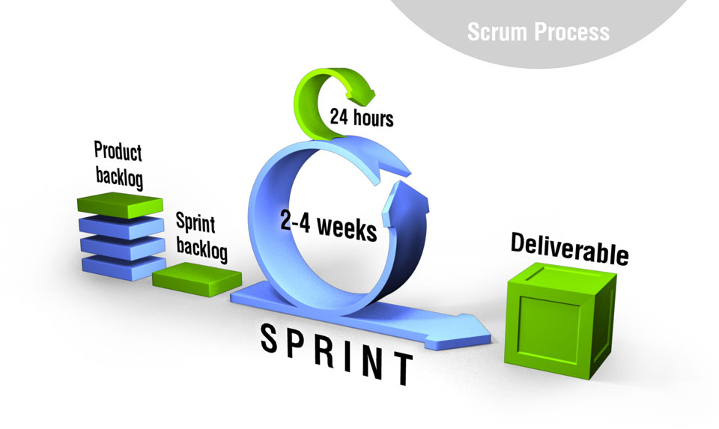
Scrum is an agile development method

Slide 92







Scrum Framework

Slide 93
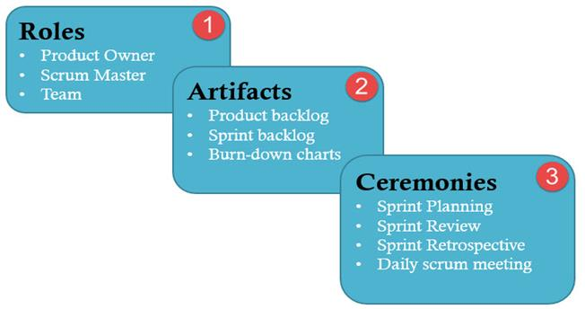
1. Roles

Slide 94
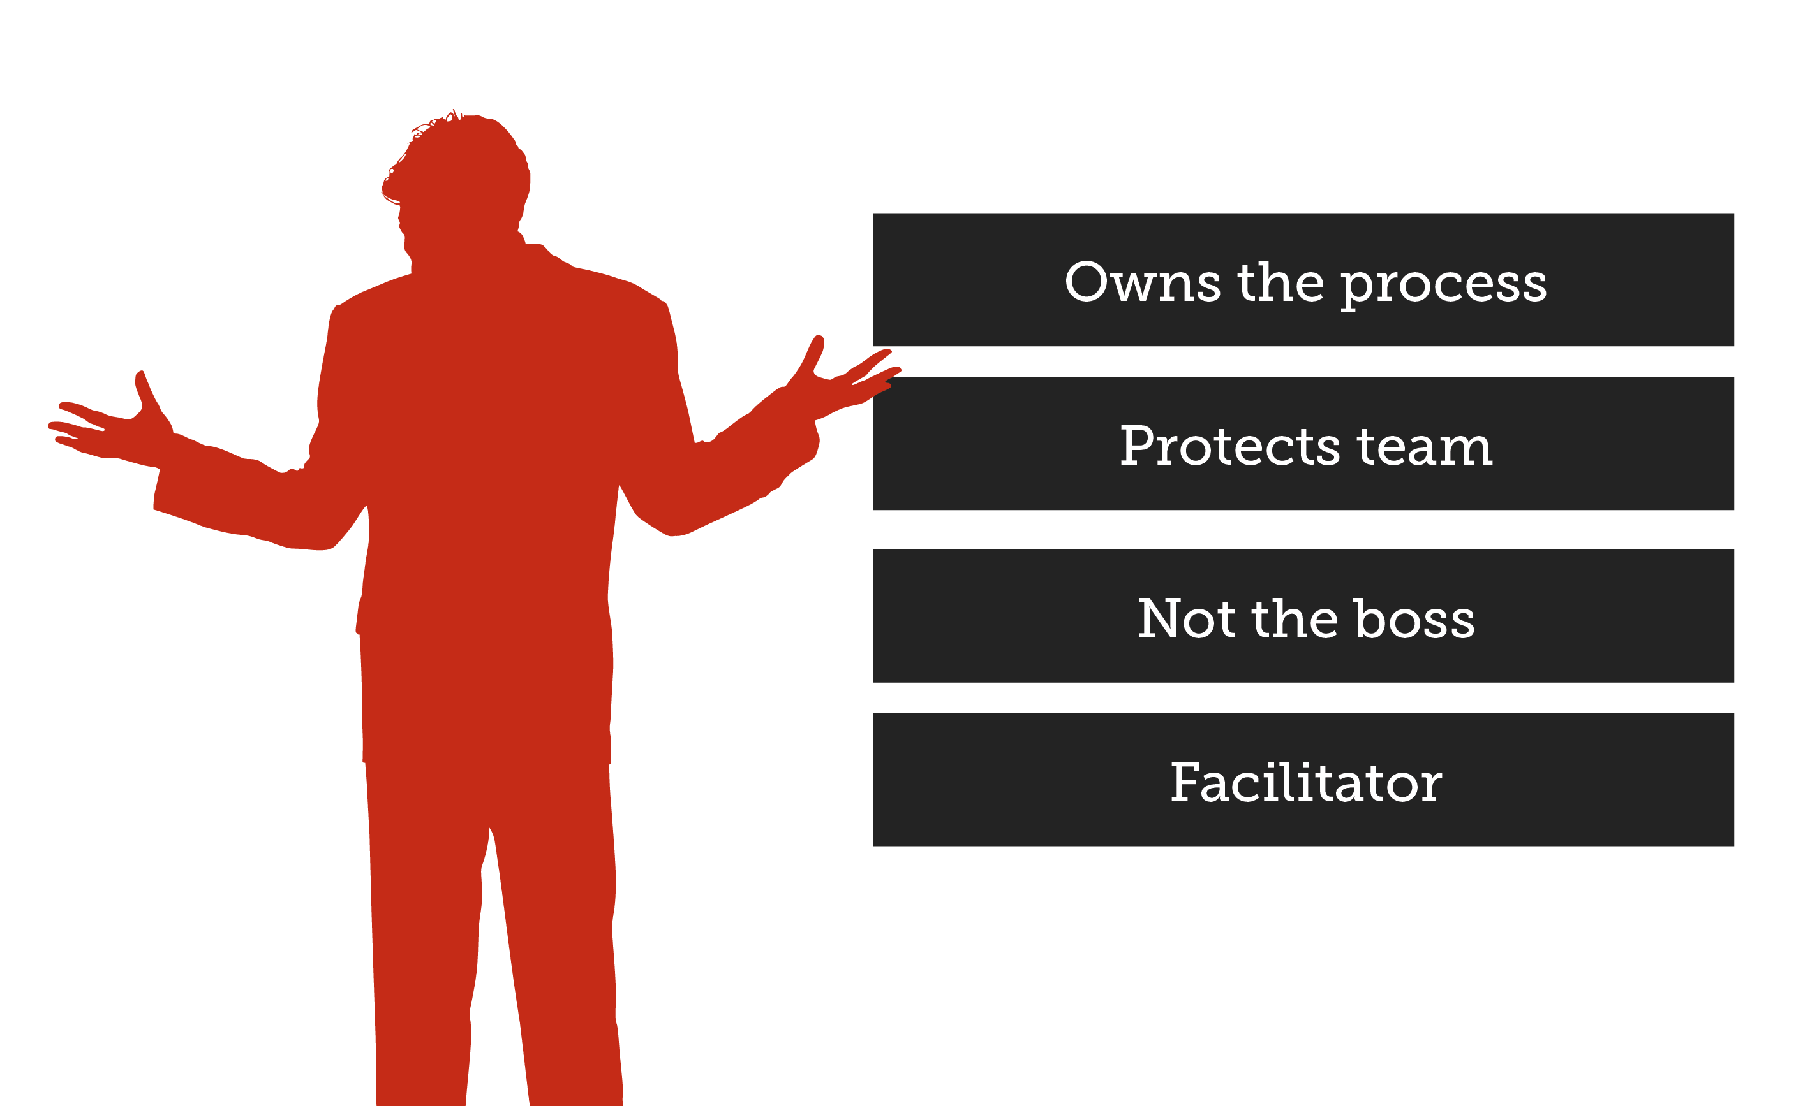
Role: 1 Scrum master
Responsibilities
1. He setting up the team and look after the team’s productivity
2. Invites to the daily scrum, sprint meetings
3. Removing obstacles to progress
4. Coordinates with all roles and functions

Slide 95

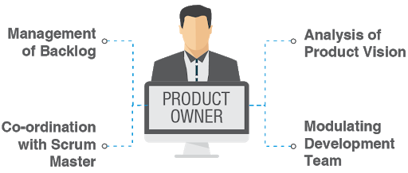
Role: 2 Product Owner
Responsibilities
1. He defines features of the Product
2. Creates product backlog
3. Decides the release date and corresponding features
4. Prioritizes the backlog (features) according to the market value
5. Getting delivery of the functionality at each iteration from scrum team

Slide 96


Role: 3 Scrum Team
Responsibilities
1. Manages its own work
2. Organizes the work to complete the sprint or cycle

Slide 97
2. Artifacts

Slide 98
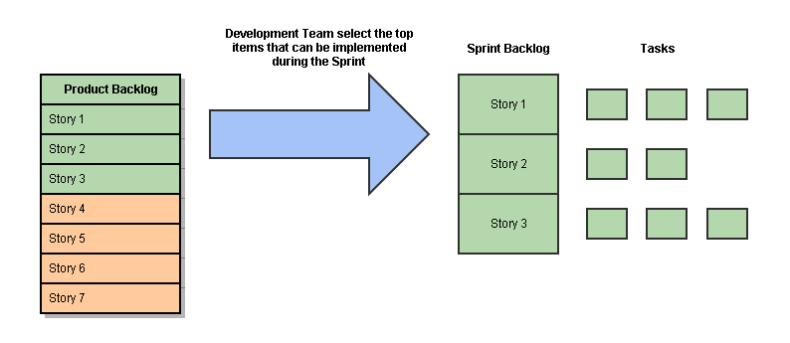
Sprint
It is a set period of time to complete the user stories, decided by the product owner and developer team, usually 2-4 weeks of time.

Slide 99

User stories
They are short explanation of functionalities of the system under test

Slide 100
1. Product Backlog
This is a repository where requirements are tracked with details on the no of requirements (user stories) to be completed for each release.
It should be maintained and prioritized by Product Owner, and it should be distributed to the scrum team.

Slide 101
2. Sprint backlog
It is a set of user stories to be completed in a sprint
During the sprint backlog, work is never assigned, and the team signs up for work on their own.
It is owned the estimated work remaining is updated daily.
It is the list of task that has to be performed in sprint

Slide 102
3. Burndown chart
A burndown chart is a graphic representation of how quickly the team is working through a customer's user stories, an agile tool that is used to capture a description of a feature from an end-user perspective.
The burndown chart shows the total effort against the amount of work for each iteration

Slide 103

How to create Burndown chart

Slide 104
Process flow of scrum
Each iteration of a scrum is known as Sprint
Product backlog is a list where all details are entered to get end-product
During each sprint, top user stories of Product backlog are selected and turned into sprint backlog
Team works on the defined sprint backlog
Team checks for the daily work
At the end of the sprint, team delivers product functionality

Slide 105
3. Ceremonies

Slide 106


1. Sprint Planning Meeting
Tester should pick a user story from product backlog that should be tested
Tester should decide how many hours (Effort Estimation) it should take to finish testing for each of selected user stories.
As a tester, He/she must know what sprint goals are.
Tester should contribute to the prioritizing process

Slide 107
Sprint
Support developers in unit testing
Test execution is performed in a lab where both tester and developer work hand in hand.
Defects are analysed during scrum meeting.
Defects are retested as soon as it is resolved and deployed for testing
Attend all daily standup meeting to speak up
Schedule testing with CI system.
Accomplish the automation test by utilizing various open source or paid tools available in the market.
Review CI automation results and send the Reports
At the end of the sprint, the tester also does acceptance testing (UAT) in some case and confirms testing completeness for the current sprint

Slide 108






2. Daily Scrum Meeting
Participants –
Client, (Product owner)
Scrum Master, (Lead)
Dev Team,
Automation Team
Functional Team (Manual)

Slide 109

3. Sprint Review Meeting
The sprint review is an informal meeting which the development team, the scrum master, the product owner and the stakeholders will attend.
The team gives a demo on the product and will determine what are finished and what aren’t.
It is mandatory to deliver a potentially shippable product increment at the end of every Sprint. So, Sprint Review meeting is held at the end of each Sprint.

Slide 110

4. Sprint Retrospective Meeting
As a tester, He will figure out what went wrong and what went right in current sprint
As a tester, He identifies lesson learned and best practices.

Slide 111

Sprint of our Project
2 weeks of sprint
1.5 years – 35 sprint
Last Sprint 35
Current Status:
First Sprint?
POC

Slide 112

20. JIRA
Defect Tracking Tool
To create a issue,
Project : Name of the Project
Issue Type : Bug/Epic/Story/Task/Subtask/New Feature
Summary : One line summary
Description : Details of the issue
Priority : High/Medium/Low/Lowest
Labels : Specific type of issue
Issue(Related To) : User can link the Issue ID to the linked issue
Assignee : Who is responsible to fix this issue.
Epic Link : If the issue belongs to any of those Epic Link
Sprint : In which Sprint, this issue addressed

Slide 113


Defect Life Cycle

Slide 114

Priority vs Severity
Severity:
How severe defect is affecting the functionality.
Priority:
How fast defect has to be fixed

Slide 115
What is Deffered
Deferred:
The bug, changed to deferred state means the bug is expected to be fixed in next releases. ...
If the tester feels that the bug no longer exists in the software, tester changes the status of the bug to “closed”.
Low priority and low severity

Slide 116
QA, QC, QE

Slide 117
Bug leakage & Bug Release

Slide 118
error defect bug

Slide 119



You are the Best

